Slide 1
Real Time Operation Systems
Focus on FreeRTOS
Hamed Jafarzadeh

Slide 2
What’s an Operating System?
Provides environment for executing programs
Process abstraction for multitasking/concurrency
Scheduling
Hardware abstraction layer (device drivers)
Filesystems
Communication
We will focus on concurrent, real-time issues

Slide 3
Do we really need one ?
Not always
Simplest approach: cyclic executive
loop
do part of task 1
do part of task 2
do part of task 3
end loop

Slide 4
Cyclic Executive
Advantages
Simple implementation
Low overhead
Very predictable
Disadvantages
Can’t handle sporadic events
Everything must operate in lockstep
Code must be scheduled manually

Slide 5
Interrupts
Some events can’t wait for next loop iteration
Communication channels
Transient events
A solution: Cyclic executive plus interrupt routines
Interrupt: environmental event that demands attention
Example: “byte arrived” interrupt on serial channel
Interrupt routine: piece of code executed in response to an interrupt
When you don’t need a lot of scheduling , Interrupts are best approaches.

Slide 6
Handling an Interrupt
1. Normal program execution
3. Processor state saved
4. Interrupt routine runs
2. Interrupt occurs
6. Processor state restored
5. Interrupt routine terminates
7. Normal program execution resumes

Slide 7
Drawbacks of Interrupts
Main loop still running in lockstep
Programmer responsible for scheduling
Scheduling static
Sporadic events handled slowly

Slide 8
Operation system comes in
Basic philosophy:
Let the operating system handle scheduling, and let the programmer handle function .
How ? :
Operation systems separate our desired tasks in some sub-routines called tasks.
It uses interrupt handling system to provide equal task times and moves between the tasks automatically which called Scheduling.

Slide 9
Real-Time Operation systems
Main goal of an RTOS scheduler: meeting deadlines so RTOS is not fair .
Fairness does not help you to meet the deadlines .
Typical RTOS based on fixed-priority preemptive scheduler

Slide 10
Real-Time Operation systems
Using a Real-Time Operation procedure :
Assign each process a priority
At any time, scheduler runs highest priority process ready to run
Process runs to completion unless preempted
Each task a triplet: (execution time, period, deadline)
Usually, deadline = period
Can be initiated any time during the period

Slide 11
Real-Time Operation systems
Execution time
Deadline
Initiation
Time
Period

Slide 12
Real-Time Operation systems
Always run the highest-priority runnable process
1
2
3

Slide 13
Closer Look
FreeRTOS
Free RTOS is an Real-Time Operation System that ported to over 35 Microcontrollers type .
It has been distributed under GPL license that makes its kernel open source but its exception lets users to keep their sources closed .
FreeRTOS is designed to be small and simple . The kernel it self consist of only 4 header files.
In order to make it easy to use , they write its kernel in C but there are few assembly functions included where needed .

Slide 14
Free RTOS
Free RTOS main features :
Provides methods for threads or tasks , mutexes , semaphores and software timers .
Provides Tick-less (?) method for reduction of consuming energy in low-power applications.
Provide some simple and easy memory allocation algorithms .
Lock feature included in critical parts of program
DelayFor and DelayUntil support .
Free RTOS is focused on speed of execution .

Slide 15
How it works ?
Free RTOS implements multiple threads by having the host program call a thread tick method at regular short intervals. The thread tick method switches tasks depending on priority and a round-robin scheduling scheme.
It mainly uses SVC interrupt to manage scheduling .
It also uses Tick Timer and pendSVC routine to start working .

Slide 16
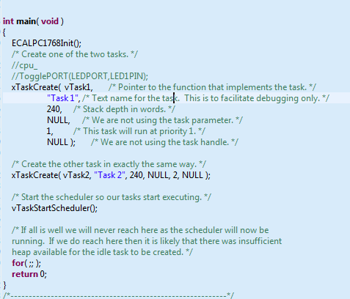
Usage Sample

Slide 17
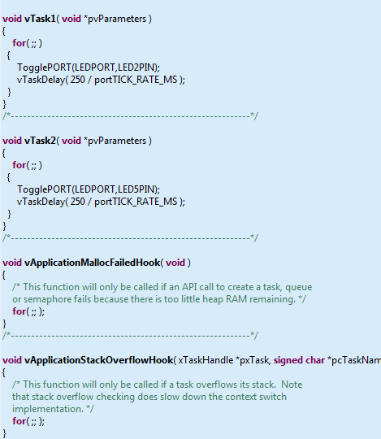
Usage Sample

Slide 18
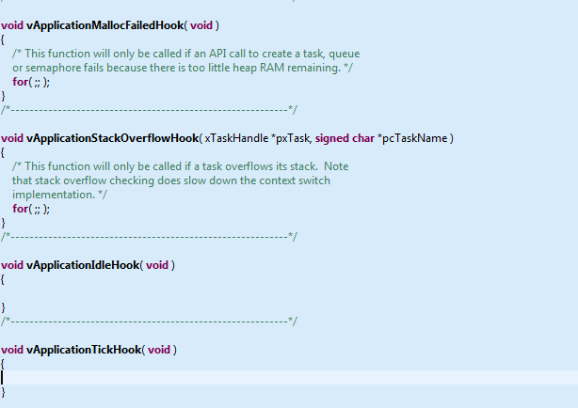
Useful Functions

Slide 19
Related Projects
Safe RTOS :
SafeRTOS was constructed as a complementary offering to FreeRTOS, with common functionality but with a uniquely designed safety-critical implementation.
The resulting requirements set was put through a full IEC 61508 SIL 3 development life cycle, the highest possible for a software-only component
OpenRTOS

Slide 20
Related Projects
Free RTOS + MicroIP
Free RTOS + TCP/IP

Slide 21
Why use Free-RTOS ? According to FreeRTOS website
Here are some reasons why FreeRTOS is a good choice for your next application - FreeRTOS...
Provides one solution for many different architectures and development tools.
Is known to be reliable. Confidence is assured by the activities undertaken by the SafeRTOS sister project.
Is undergoing continuous active development.
Has a minimal ROM, RAM and processing overhead. Typically an RTOS kernel binary image will be in the region of 4K to 9K bytes.
Is very simple - the core of the RTOS kernel is contained in only 3 C files. The majority of the many files included in the .zip file download relate only to the numerous demonstration applications.
Is truly free for use in commercial applications (see license conditions for details).
Comes with a porting, platform development, or application development service should it be required.
Is well established with a large and ever growing user base.
Contains a pre-configured example for each port. No need to figure out how to setup a project - just download and compile!
Has an excellent, monitored, and active free support forum.
Has the assurance that commercial support is available should it be required.
Provides ample documentation.
Is very scalable, simple and easy to use.
FreeRTOS offers a smaller and easier real time processing alternative for applications where eCOS, embedded Linux (or Real Time Linux) and even uCLinux won't fit, are not appropriate, or are not available.

